Slide 1
House Price Prediction Project.
Submitted by : Vijay

Slide 2
INTRODUCTION
in this project, we have built a machine learning model to predict the house prices
This project will very helpful for the real estate market and consumer also to check the price of the house.
Our model also helpful for both house seller and house buyers.

Slide 3
Problem Statement
Price of real estate property are sophisticatedly linked with our economy.
Despite this we do not have accurate measures of house prices based on the amount of the data.
Understanding various factors that influence the House prices.
Proper and justified prices of property can bring in a lot of transparency and trust back to the real estate industry which is very important for most consumers.

Slide 4
Data Visualization and analysis
In this step we will analyze and visualize our data
We will use tools available in python for data analysis and visualization.
We will use NumPy for Numerical analysis
Pandas for performing operation on data frame
Matplotlib Provide visualization capability.
We will use Seaborn for more enhanced visualization and analysis.

Slide 5
Dataset For This Project
For This Project, For This Project, We Are Using the US-based housing company named Surprise Housing House Dataset that contain 1460 rows and 81 columns

Slide 6
EDA Steps
During EDA we have performed many types of transformations to create the dataset.
After That we will see the shape of the data and check the null values present in the data.
Data is having Some null values and all the data is a different data type.
As the data is a Different data type we will perform the various type of plots.

Slide 7
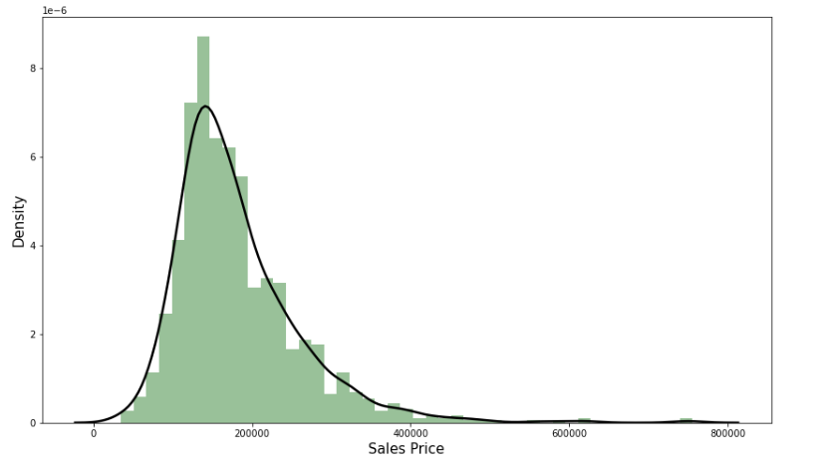
Here We See Price Distribution Of The Sales Price And Here We See The Almost House Price Is in Between 150000 To 225000 And That Is Also Important Factors.

Slide 8
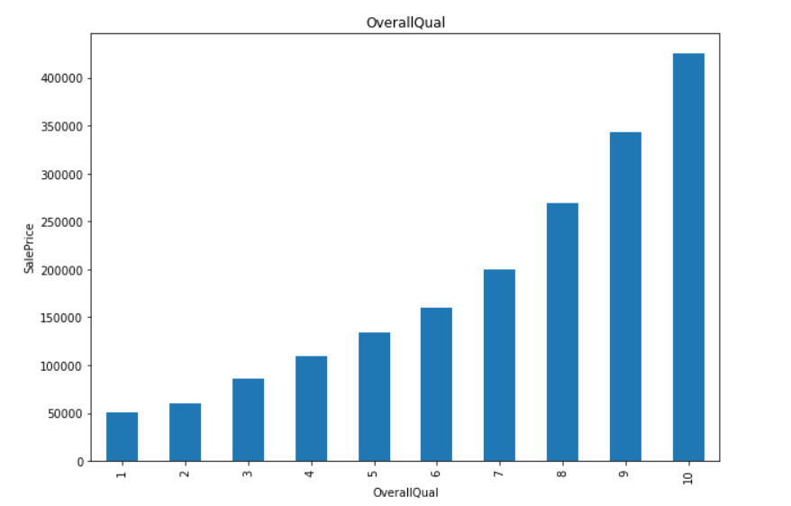
Here We See That The Condition Of The House Price Is Higher.

Slide 9
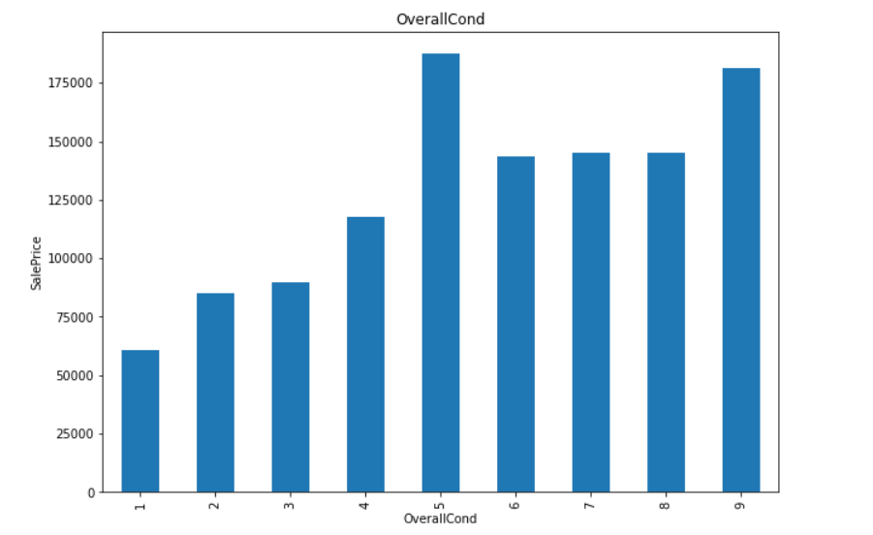
Here We See That The Over Roll Condition Is Impact The Price Of The House.

Slide 10
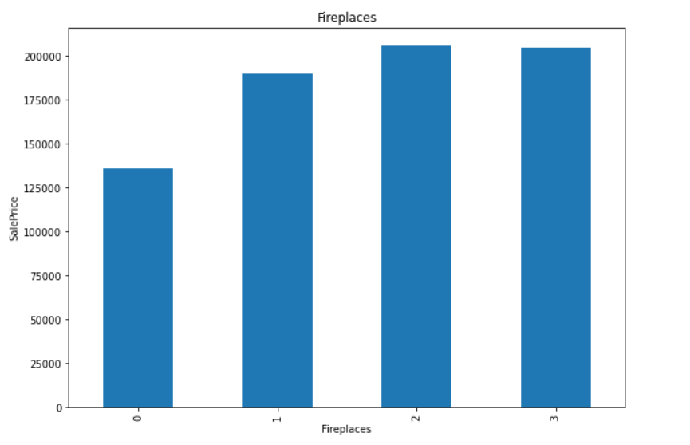
In This Chart, We See That The Fireplace Is Impact The Price Of The House.

Slide 11
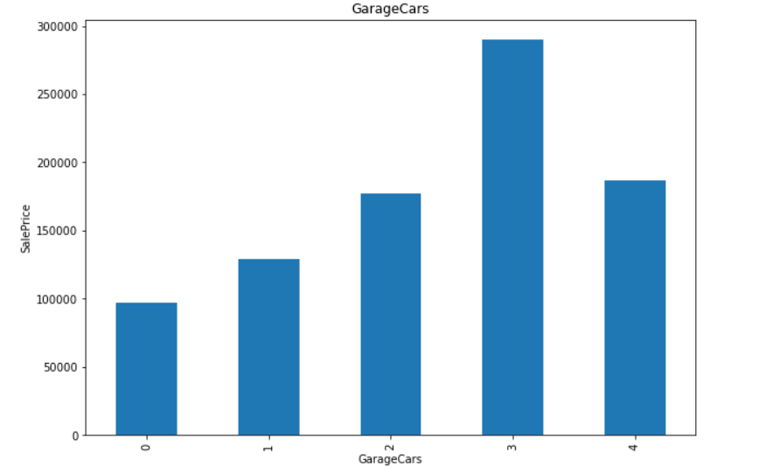
In This Chart, We See That The Size Of Garage In Car Capacity That Also Impact The House Prices.

Slide 12
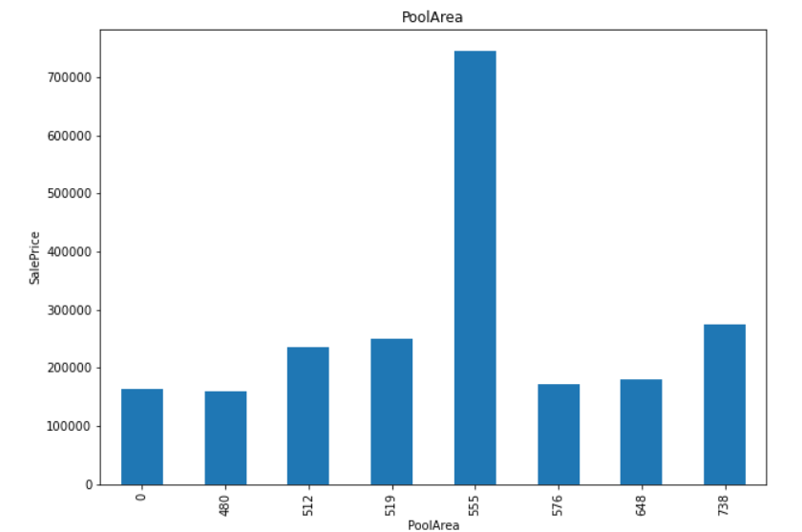
In This Chart, We See That The Poll Area That Is Impact The Price Of The House.

Slide 13
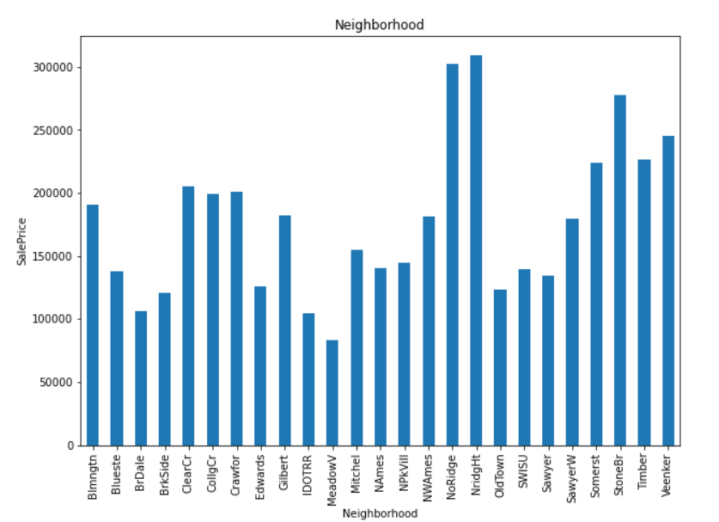
In This Chart, We See The Neighborhood Also Impact The House Prices.

Slide 14
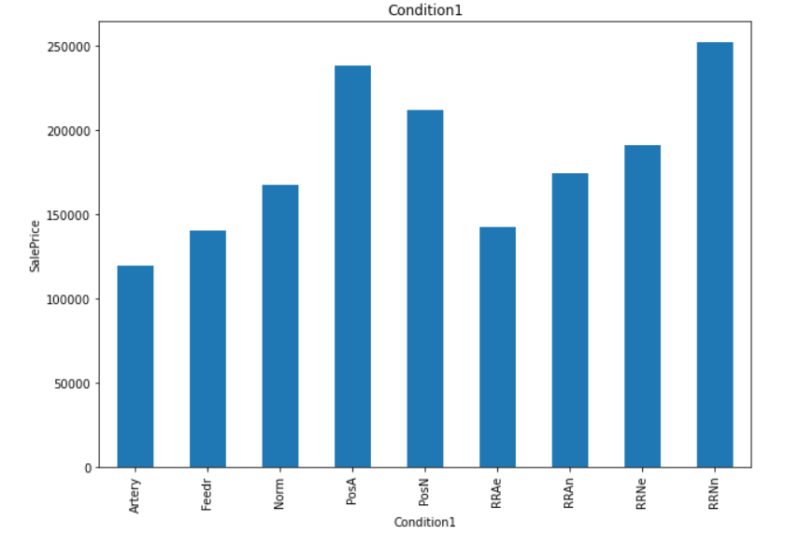
In This Chart, We See The Over Roll Condition Of The House That Also Impact The Price Of The House.

Slide 15
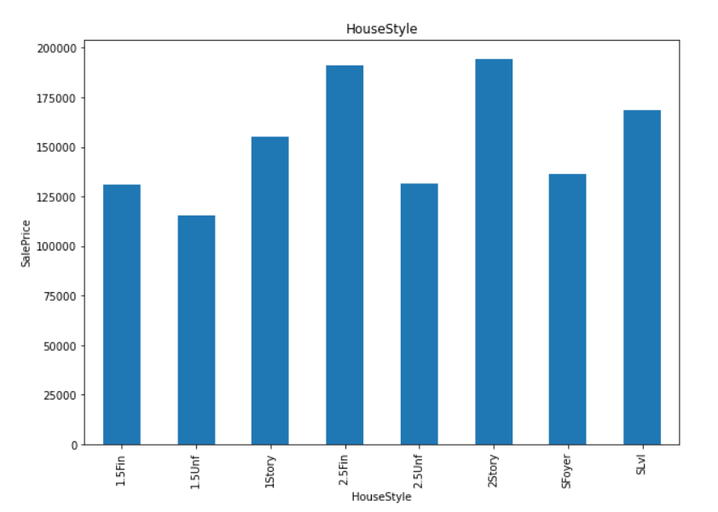
In This Chart, We See The House Style That Impact The House Price And This Is Most Important To Predict Any House Price.

Slide 16
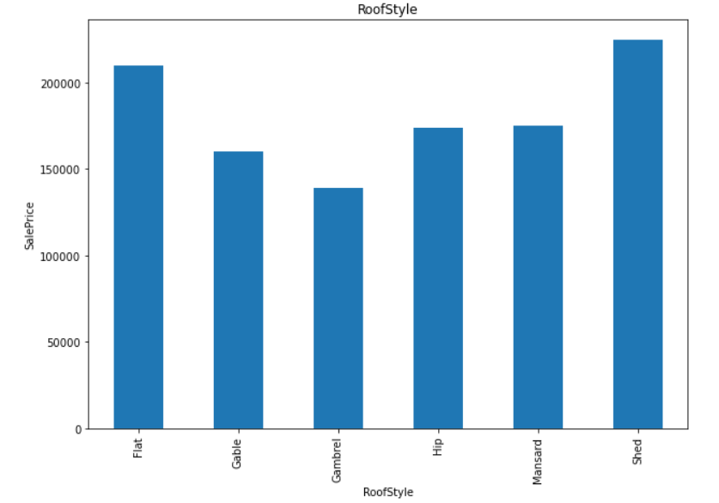
In This Chart, We See The Roof Style Is Also Impact The Price Of The House.

Slide 17
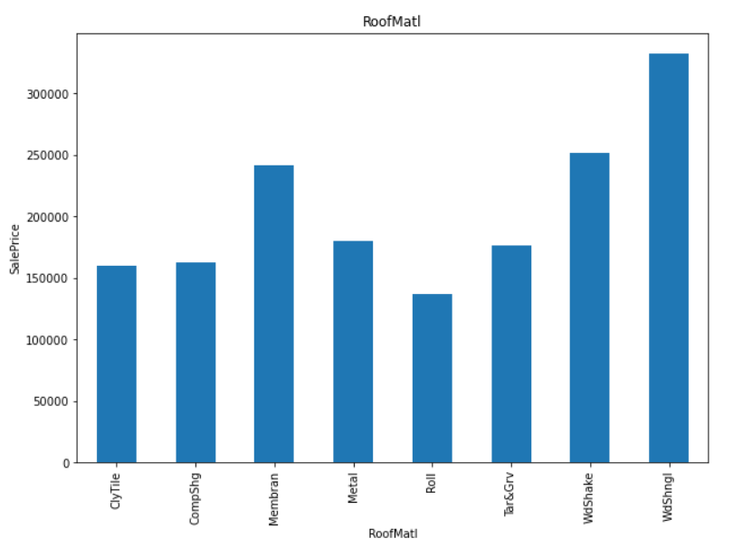
In This Chart, We See The Roof Materials Od The House Is Also Impact The Price Of The House.

Slide 18
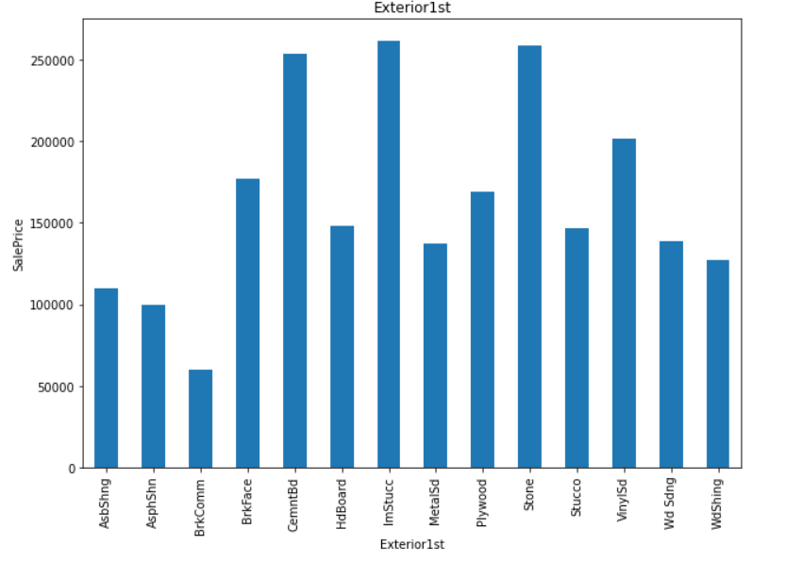
In This Chart, We See Exterior Is Also Impact The House Prices.

Slide 19
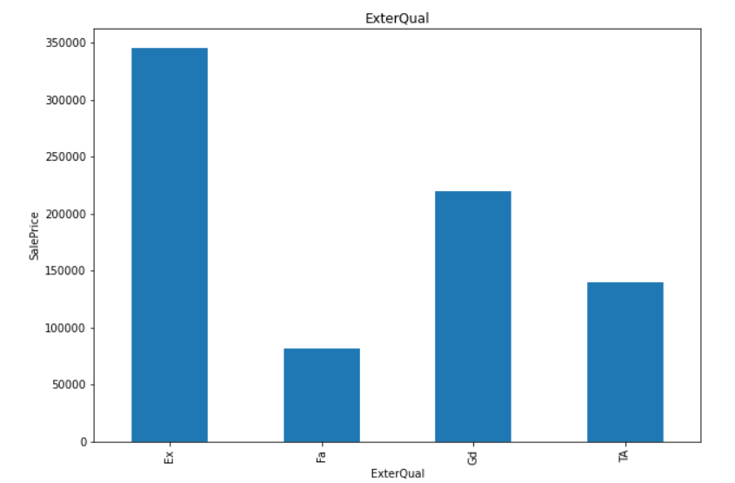
In This Chart, We See The External Quality Of The House Is Also Important Factor Of The House Price.

Slide 20
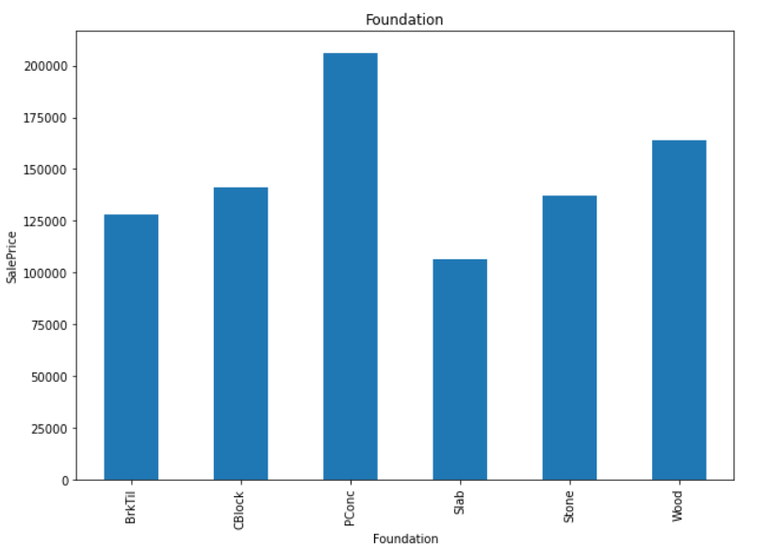
In This Chart, We See The Foundation Of The House Is Impact The Price Of The House.

Slide 21
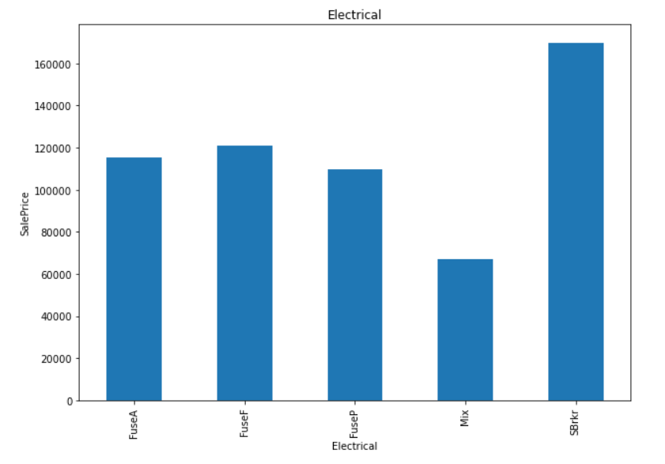
In This Chart, We See The Electrical Features That Impact The House Prices.

Slide 22
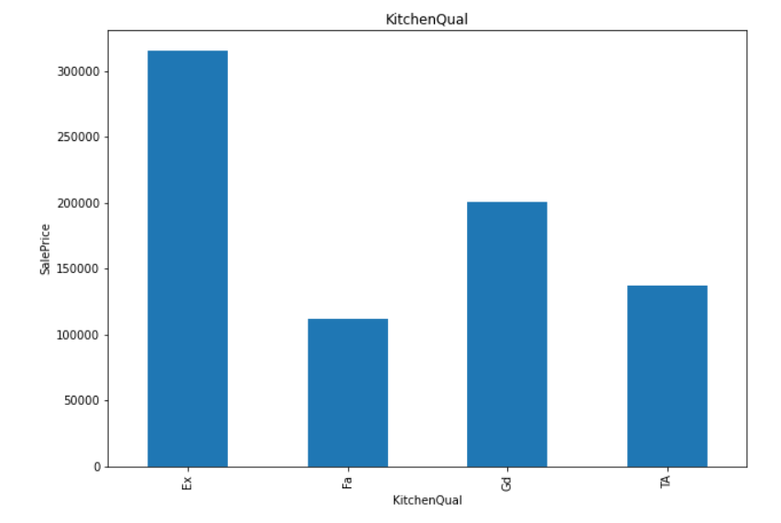
In This Chart, We See The Kitchen Quality Is Impact The House Prices.

Slide 23
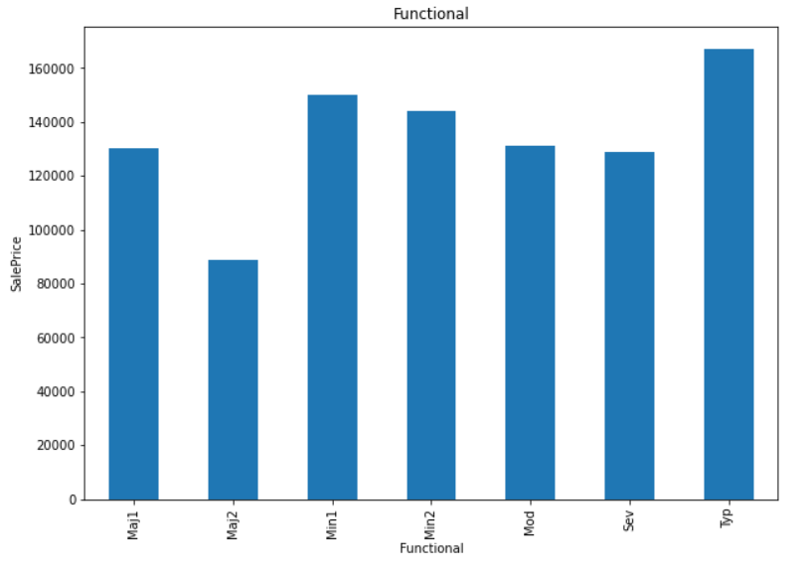
In This Chart, We See The Functional Of House Also Impact The House Prices.

Slide 24
Conclusion
The main goal of this project is to determine the prediction for prices which we have successfully done using different machine learning algorithms like a Random forest, multiple regression, Support vector machine, gradient boosted trees. And research provides us to find the attributes contribution in prediction. So, I would believe this research will be helpful for the peoples.

